Slide 1
Capstone Project-3 Supervised ML- Classification COMPANY BANKRUPTCY PREDICTION
BY:
Kanika Bhardwaj

Slide 2
Outlines to Discuss:
Introduction
Exploring dataset
Feature Selection
EDA and Data Processing
Applying the models
Conclusion

Slide 3
Problem Statement
Prediction of bankruptcy is a phenomenon of increasing interest to firms who stand to loose money because on unpaid debts. Since computers can store huge dataset pertaining to bankruptcy making accurate predictions from them before hand is becoming important.
The data were collected from the Taiwan Economic Journal for the years 1999 to 2009. Company bankruptcy was defined based on the business regulations of the Taiwan Stock Exchange.
In this project you will use various classification algorithms on bankruptcy dataset to predict bankruptcies with satisfying accuracies long before the actual event.

Slide 4
Data Pipeline
The data were collected from the Taiwan Economic Journal for the years 1999 to 2009. Company bankruptcy was defined based on the business regulations of the Taiwan Stock Exchange.
The dataset consists of 96 features including dependent variable and 6819 rows.
Cleaning the data: The data was checked for null values and categorical values.
Feature selection: Correlated values are used as important features.
EDA: To check the skewness and removing the outliers.
Model Testing: Combination of different models are used to get the optimal result.

Slide 5
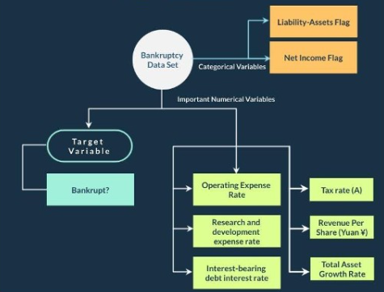
Data Summary

Slide 6
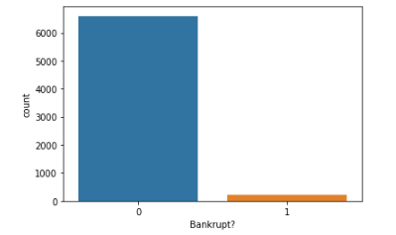
Visualize the target variable
We can see that there is high imbalance in dependent variable. Only 220 out of 6819 companies are bankrupt.
Hence we apply SMOTE technique to balance this feature.

Slide 7
Feature Selection
Checking for correlation among the features using heatmap is good but it is very difficult to get an insight from the heatmap as we have huge number of features in our dataset.
Hence, we're taking the correlated features using feature selection.
Using feature selection we get 25 columns which are highly correlated. We will proceed with these features.

Slide 8
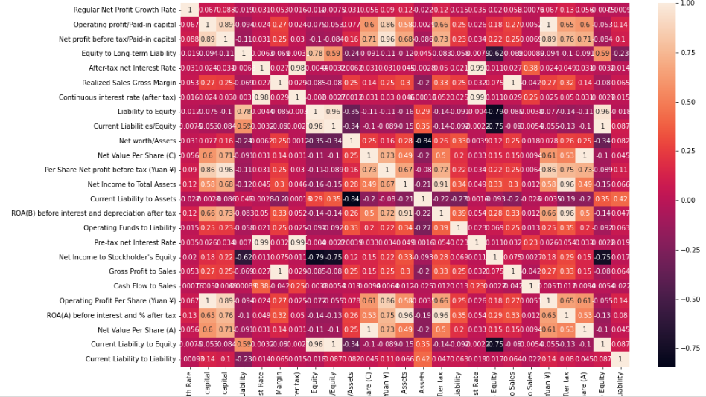
Correlation between selected features.

Slide 9
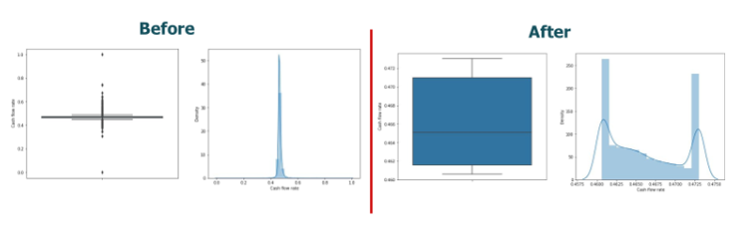
Detecting and capping outliers
The data has many outliers and it can be seen that it is very skewed.
Many columns are highly skewed, both in left and right direction.
We found that a lot of columns have high kurtosis.
A company is more likely to go bankrupt, if the value of features such as ROA(A) value is low.
Outliers are capped at 80 percentile value at upper side and 20 percentile at lower side

Slide 10
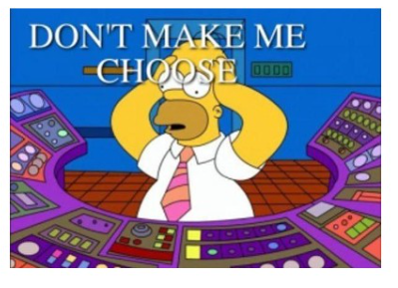
Model Testing
We use different types of model for testing, like:
Logistic Regression
K- Nearest Neighbors
Kernel SVM
Gaussian Naive Baye's
Decision Tree
Random Forest
XG-Boost

Slide 11
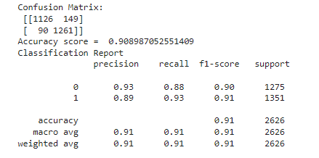
Model Testing by Logistic regression
Here we get accuracy score 90.89%
F1 score as 91%

Slide 12
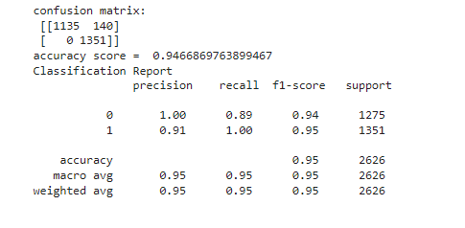
Model Testing by K Nearest Neighbors

Slide 13
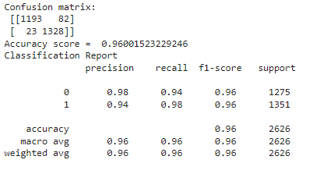
Model Testing by XG boost

Slide 14
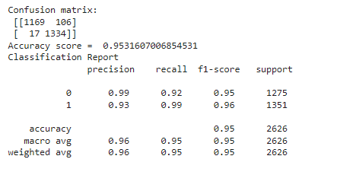
Model Testing by Kernel SV

Slide 15
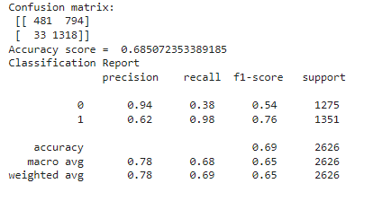
Model Testing by Gaussian Naive Baye's

Slide 16
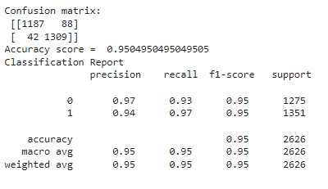
Model Testing by Decision Tree

Slide 17
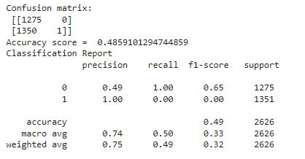
Model Testing by Random Forest

Slide 18
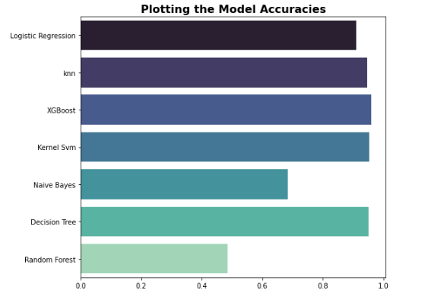
Comparing accuracies:
XG Boost has highest accuracy than any other models.
While Random Forest has poor accuracy.

Slide 19
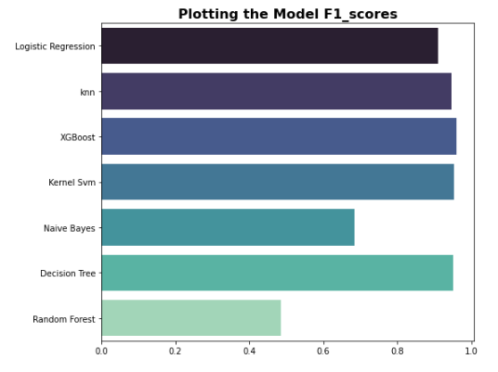
Comparing f1_score:
F1_score of XG Boost is higher than any other model while Random forest has lowest score.

Slide 20
Conclusion
We find that two different Machine Learning algorithms, Logistic Regression, Decision Tree, K Nearest Neighbor, Random Forest (RF) and Extreme Gradient Boosting (XGBoost) produce accurate predictions of whether a firm will go bankrupt features.
The XGBoost based models perform exceptionally well, with 96% out-of-sample accuracy.
This study has used a substantially larger training dataset as compared to previous studies.
An application of our best performing XGBoost. Extreme Gradient Boosting (XGBoost) produce accurate predictions of whether a firm will go bankrupt with the selected features.

Slide 21
Challenges
Balancing the trade off between recall and precision was a major challenge.
Feature selection and choosing the right technique
Deadline felt a little strained. But it all worked out for the best.

